Slide 1

Modelling Soil Carbon Content Across Georgia State
Presented By:
Amrinder Jakhar
Anish Bhattarai
Binita Ghimire
Rajneesh Sharma

Slide 2
Outline
BACKGROUND 3
OBJECTVIES 6
METHOD 7
RESULTS 12
CONCLUSION 18

Slide 3

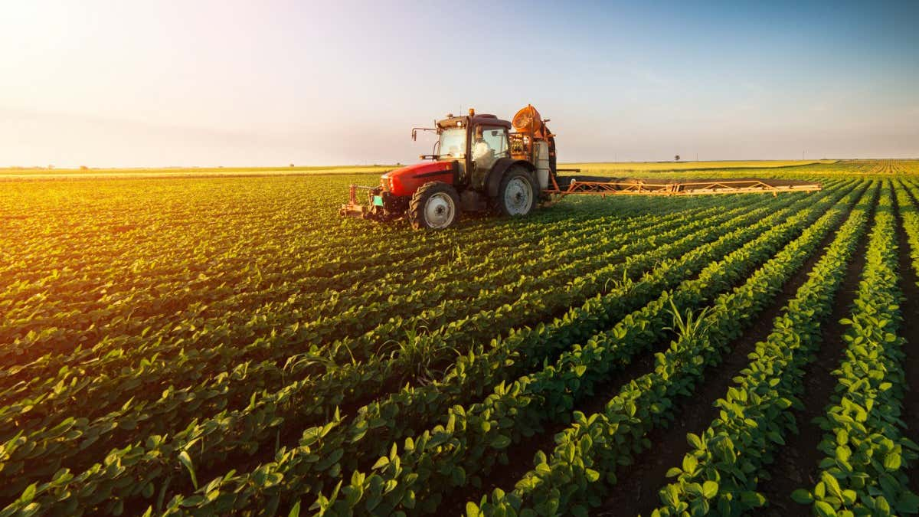

Soil Organic Carbon
Soil Health
Agriculture
Climate Change
Notes:
https://kellytillage.com/us/improve-soil-health-techniques/
https://www.newscientist.com/lastword/mg25433813-000-how-many-humans-would-there-be-if-agriculture-hadnt-been-invented/

Slide 4
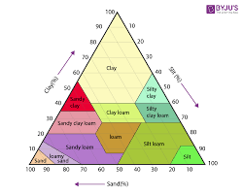
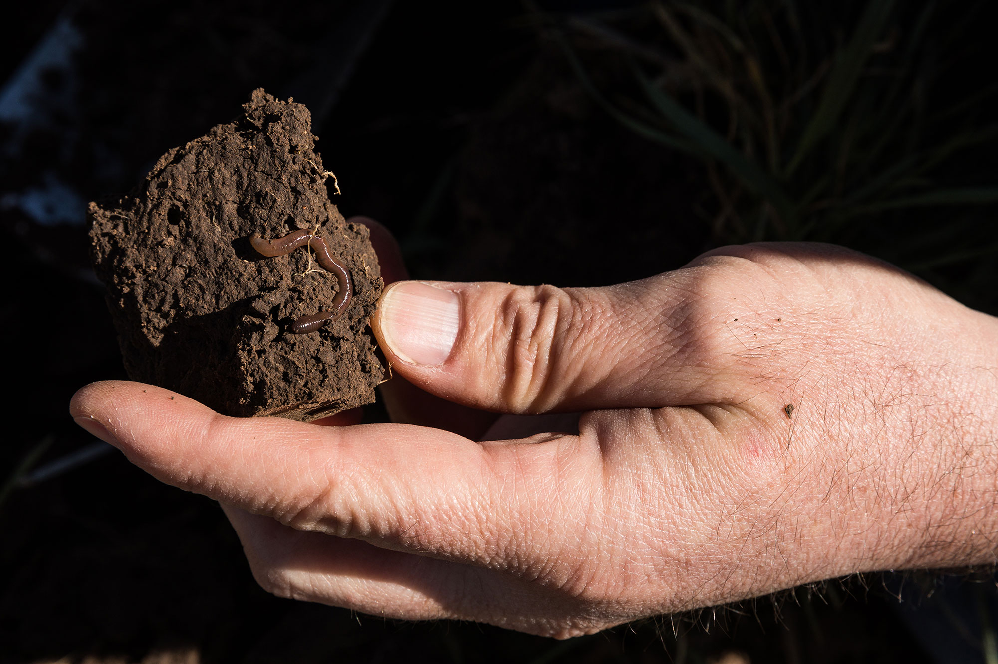



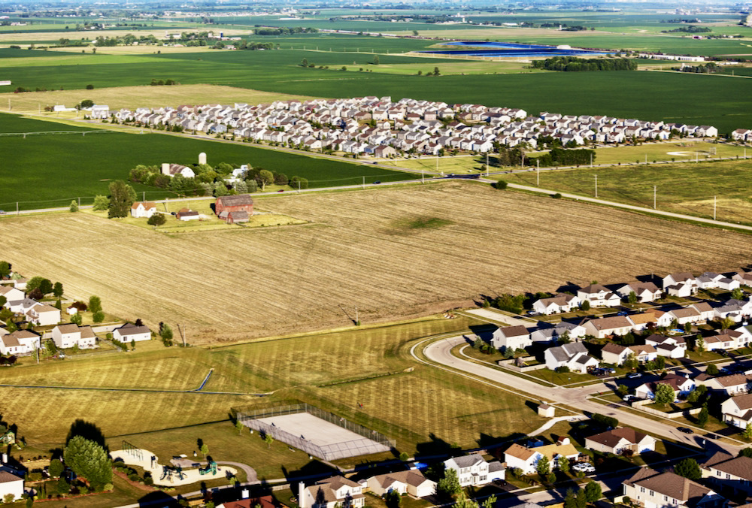
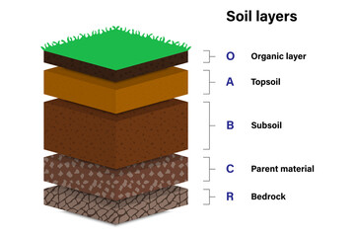
Factors Affecting Soil Carbon- SCORPAN
McBratney et al. 2003 & Minasny 2013
soil properties: soil type, soil aggregation, texture (especially silt and clay content), clay mineralogy;
soil biology (microbiota and fauna);
topography (e.g. slope & aspect) and how this influences soil moisture;
climate (temperature and precipitation);
land cover history and vegetation type (e.g. forests, prairie);
land use and land management (e.g. cropping history);
soil parent material and its contribution to soil minerals, texture and soil type;

Slide 5
Objectives
Developing a Soil Organic Carbon (SOC) Predictive Model for various soil depths
Exploring interpolation and extrapolation of SOC across spatial scales
Understanding factors influencing SOC distribution at various depths

Slide 6
Methods

Slide 7
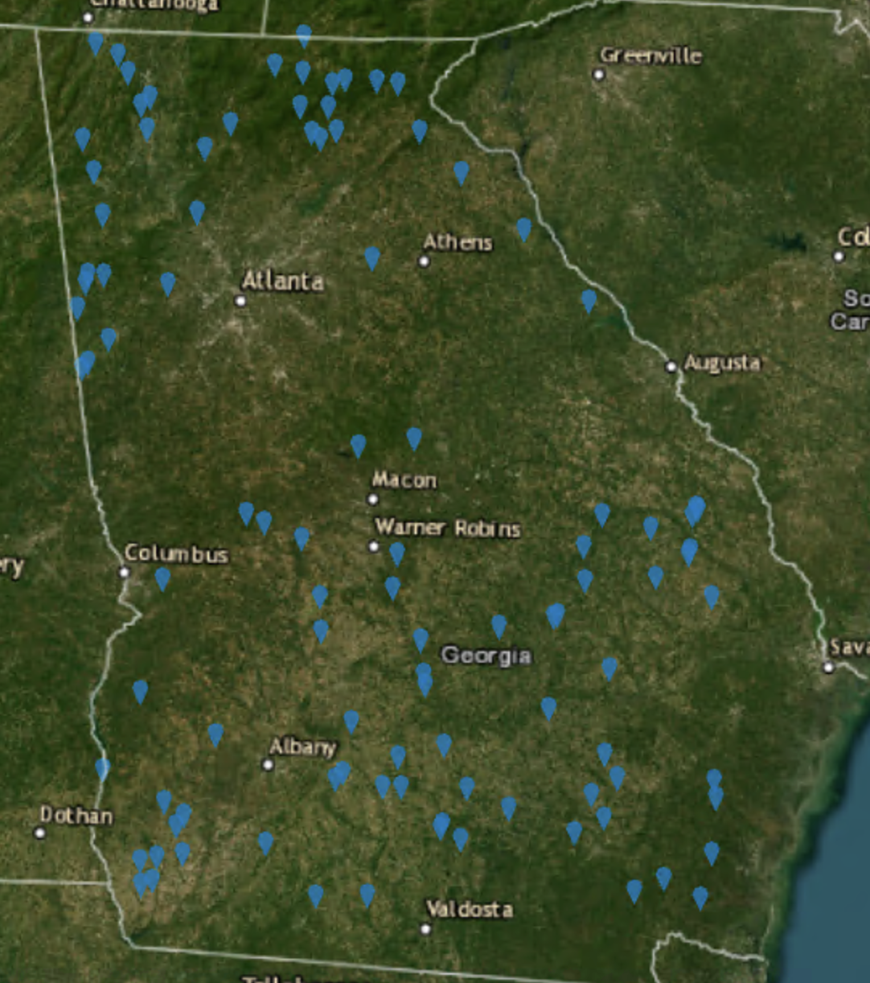
Study Area
State of Georgia
SOC Data
Source: Raca Dataset
Total Number of points: 103
Time period: 2010 - 2013

Slide 8
Variable Considered in the Study
Precipitation
Temperature
Standardized precipitation Index
Palmer Drought Severity Index
Soil Texture
Crop Land Data

Slide 9

Temperature & Precipitation
Yearly average from PRISM with 4 Km resolution for 2009-2013 (https://prism.oregonstate.edu/)
With an increase in temperature, evaporation is enhanced, and plant productivity is reduced, ultimately resulting in a decrease in soil organic carbon input
As rainfall increases, more residues return to the soil from grasses or trees. At the same time, soils in high rainfall areas may have less organic matter decomposition than well-aerated soils.

Slide 10
Standardized Precipitation Index
Number of standard deviation by which precipitation anomaly deviate from mean.
More comparable to across different climate regions
A standardized index based on a simplified soil water balance and estimates relative soil moisture conditions.
Source: Gridmet Drought: CONUS Drought Indices
Palmer Drought Severity Index (PDSI)

Slide 11
Soil Texture
The proportion of sand, silt and clay sized particles that make up the mineral fraction of the soil
Affect the physical structure and organic matter retention
Clay-rich soils typically storing more carbon than sandy soils.
Source: OpenLandMap Soil Texture Class (USDA System)

Slide 12
Crop Land Data
The types of crops grown, agricultural practices, and land use on a specific area of land.
Provide idea on management practices like crop rotation, tillage practices, crop residue management, which affect sequestration or depletion of organic carbon.

Slide 13
Model Design

Slide 14


Slide 15
Target-oriented validation
Total Data Available
Loc 1
Loc 2
Loc 3
Loc 4
Loc 5
Loc 6
Time 1
Time 2
Time 3
Time 4
Time 5

Slide 16
Target-oriented validation
Random K fold validation
Training Dataset
Validation Dataset
Loc 1
Loc 2
Loc 3
Loc 4
Loc 5
Loc 6
Time 1
Time 2
Time 3
Time 4
Time 5

Slide 17
Target-oriented validation
Leave Location Out – Spatial Blocking
Training Dataset
Validation Dataset
Loc 1
Loc 2
Loc 3
Loc 4
Loc 5
Loc 6
Time 1
Time 2
Time 3
Time 4
Time 5

Slide 18
Target-oriented validation
Leave Time Out – Temporal Blocking
Training Dataset
Validation Dataset
Loc 1
Loc 2
Loc 3
Loc 4
Loc 5
Loc 6
Time 1
Time 2
Time 3
Time 4
Time 5

Slide 19
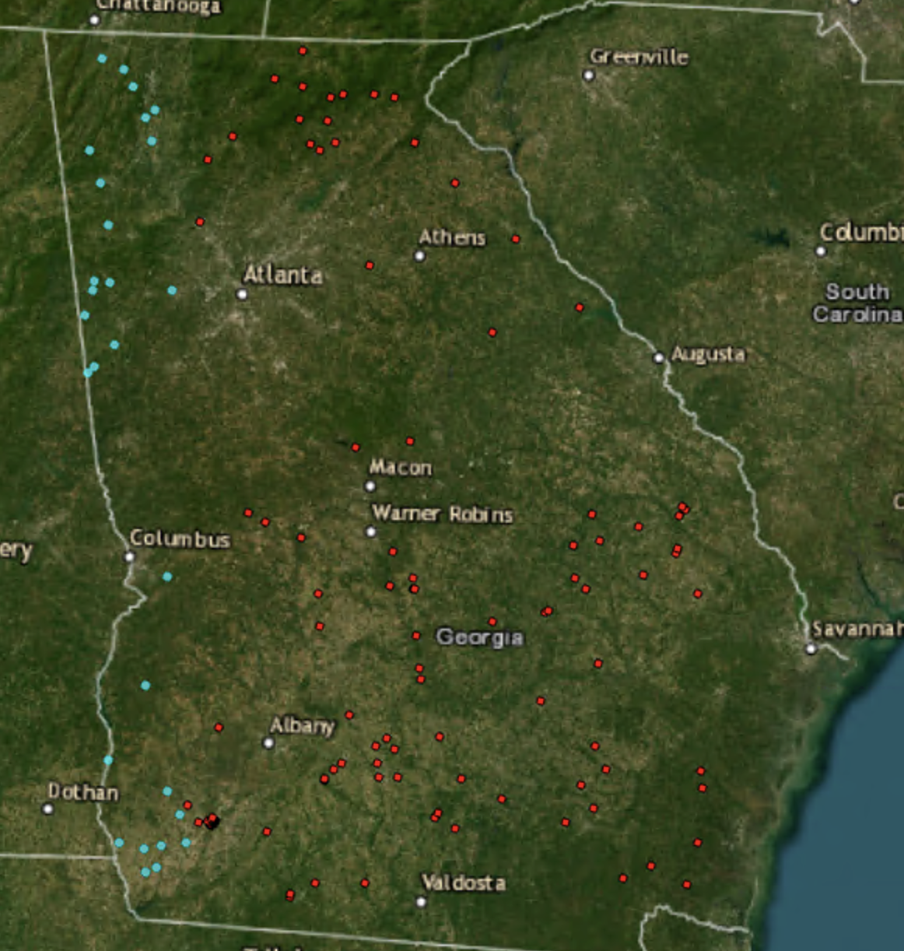
Training and Testing Split
Training: 78 points
Testing: 25 points

Slide 20
Model Frame-work
SOC 0 – 10 cm
Random Cross Validation Model
Spatially Split for Training Data
Testing accuracy and error metrics
SOC 10 – 30 cm
LLO Cross Validation Model
Spatially Split for Testing Data
Feature Imporatance
Covariables
FFS & LLO Cross Validation Model
Random Forest Models

Slide 21
Results

Slide 22
Performance metrics of RF model for two soil depts
Model Type | R squared | Adj R squared | RSE | P value
SOC 0 – 10 cm
Random | 43 | 41 | 0.83 | ***
LLO | 42 | 40 | 0.82 | ***
FFS_LLO | 26 | 23 | 0.47 | ***
SOC 10 – 30 cm
Random | 37 | 34 | 0.83 | ***
LLO | 38 | 35 | 0.83 | ***
FFS_LLO | 33.6 | 31 | 0.36 | ***

Slide 23
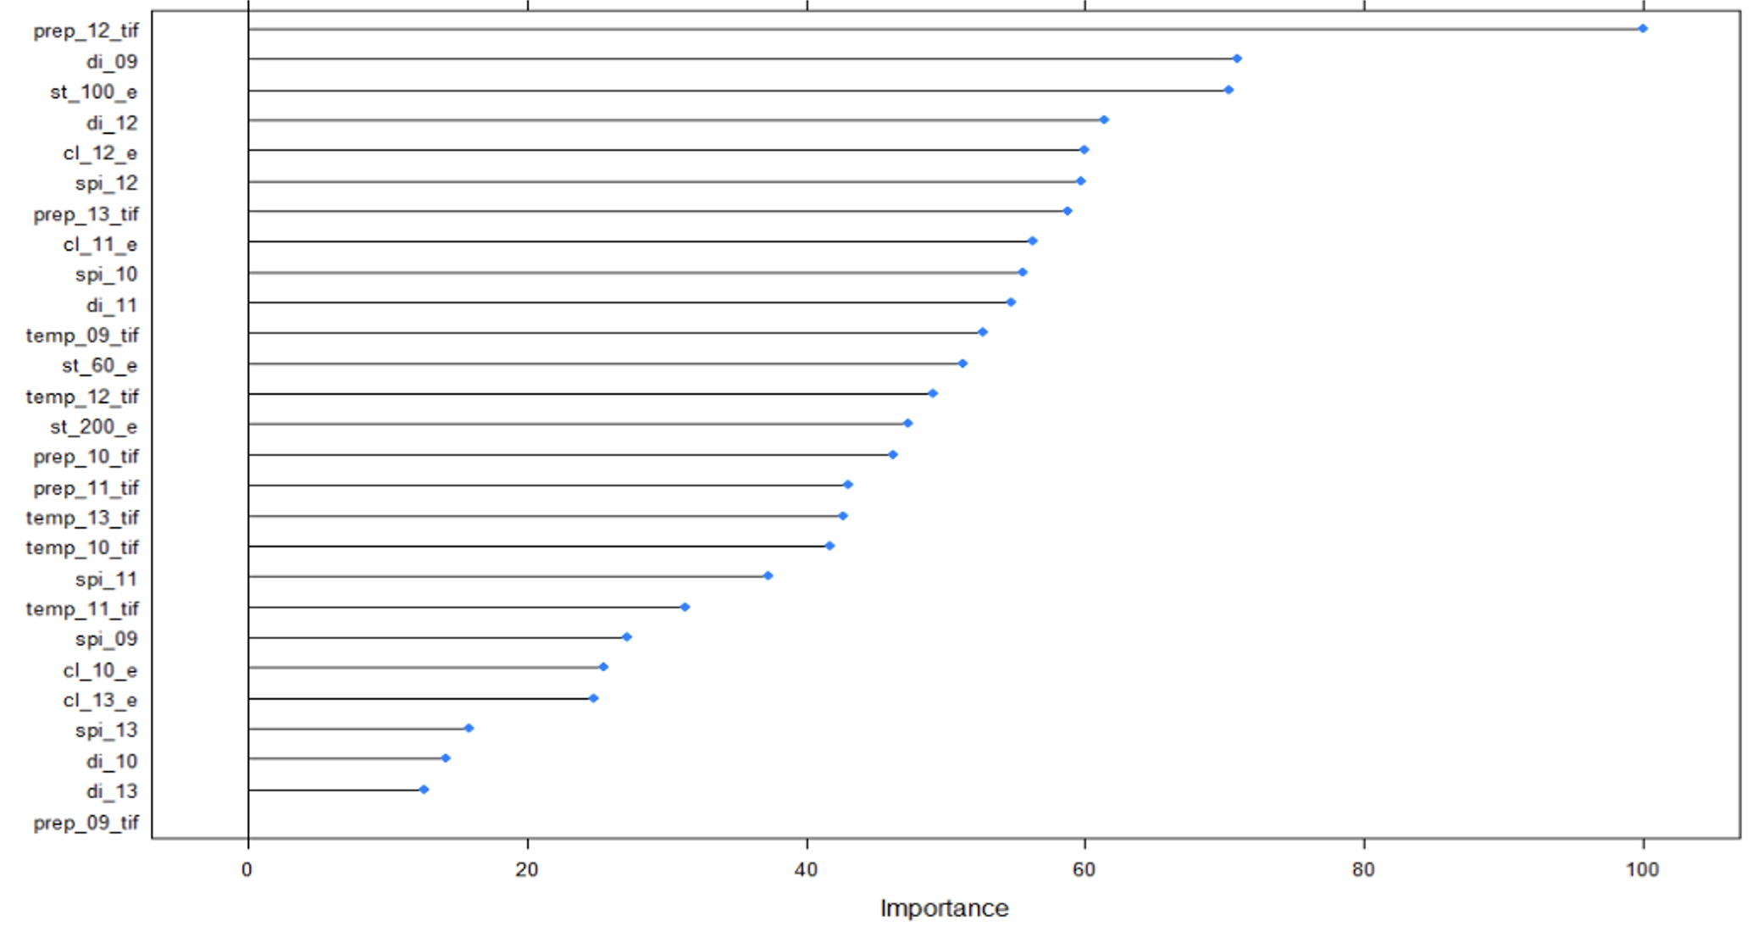
Random Model VarImp Soc 0 – 10 cm

Slide 24
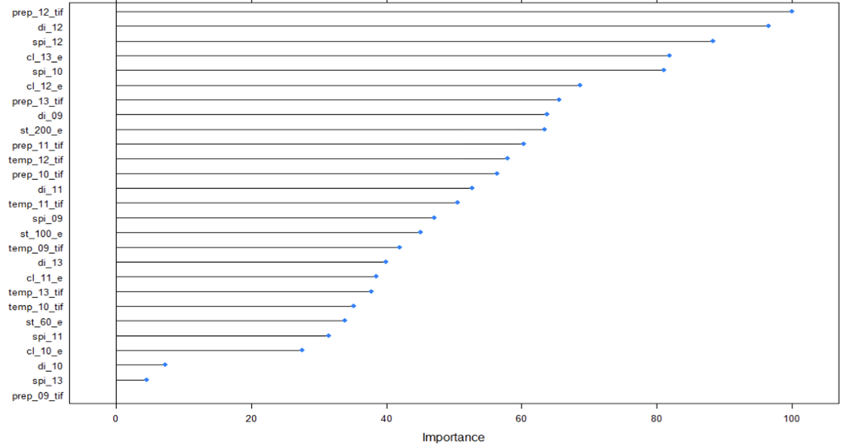
LLO Model VarImp Soc 0 – 10 cm

Slide 25
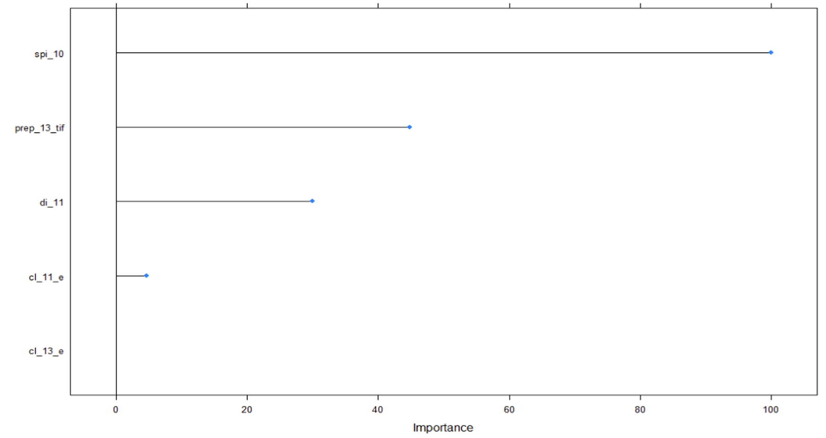
FFS_LLO VarImp Soc 0 – 10 cm
Standard Precp Index
Prism Precp
Drought Index
Crop Land Cover
Crop Land Cover

Slide 26
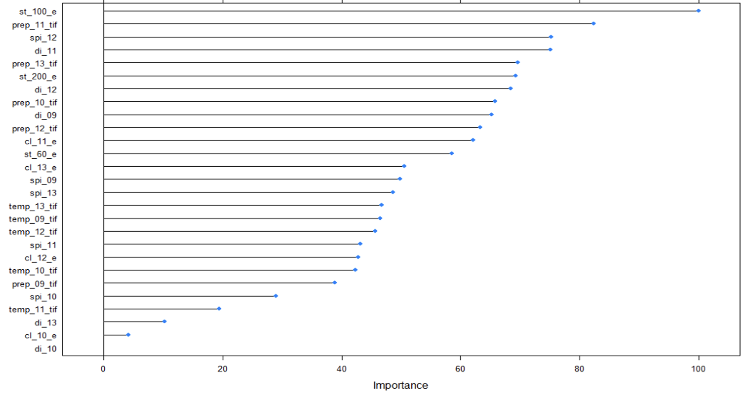
Random Model VarImp Soc 10 – 30 cm

Slide 27
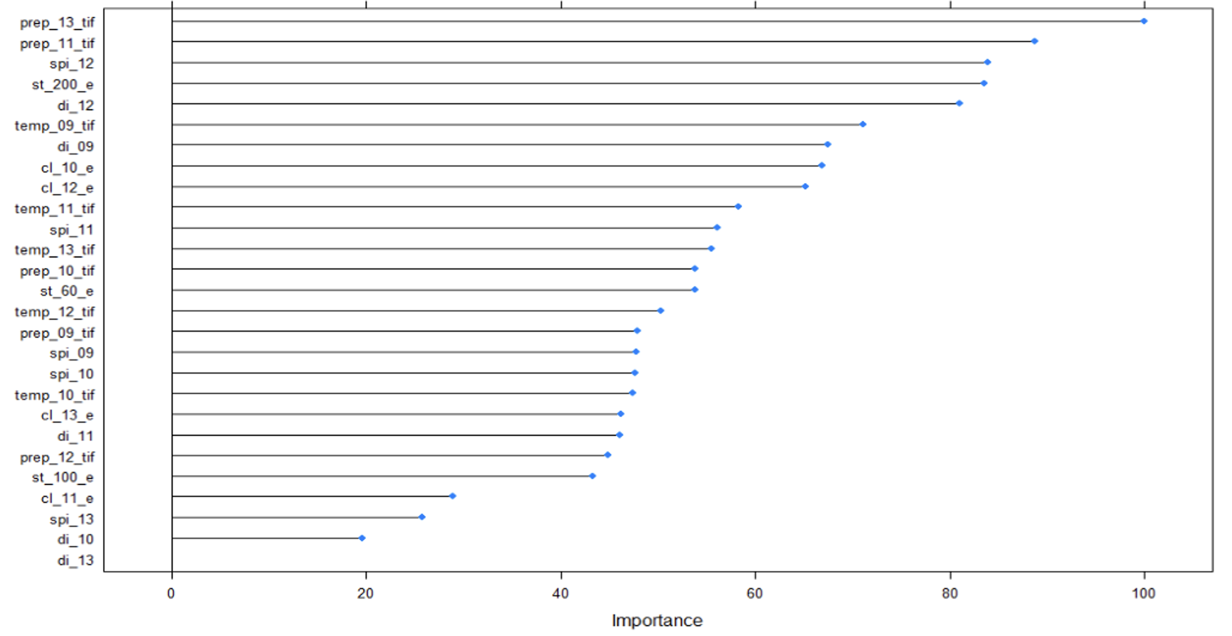
LLO Model VarImp Soc 10 – 30 cm

Slide 28
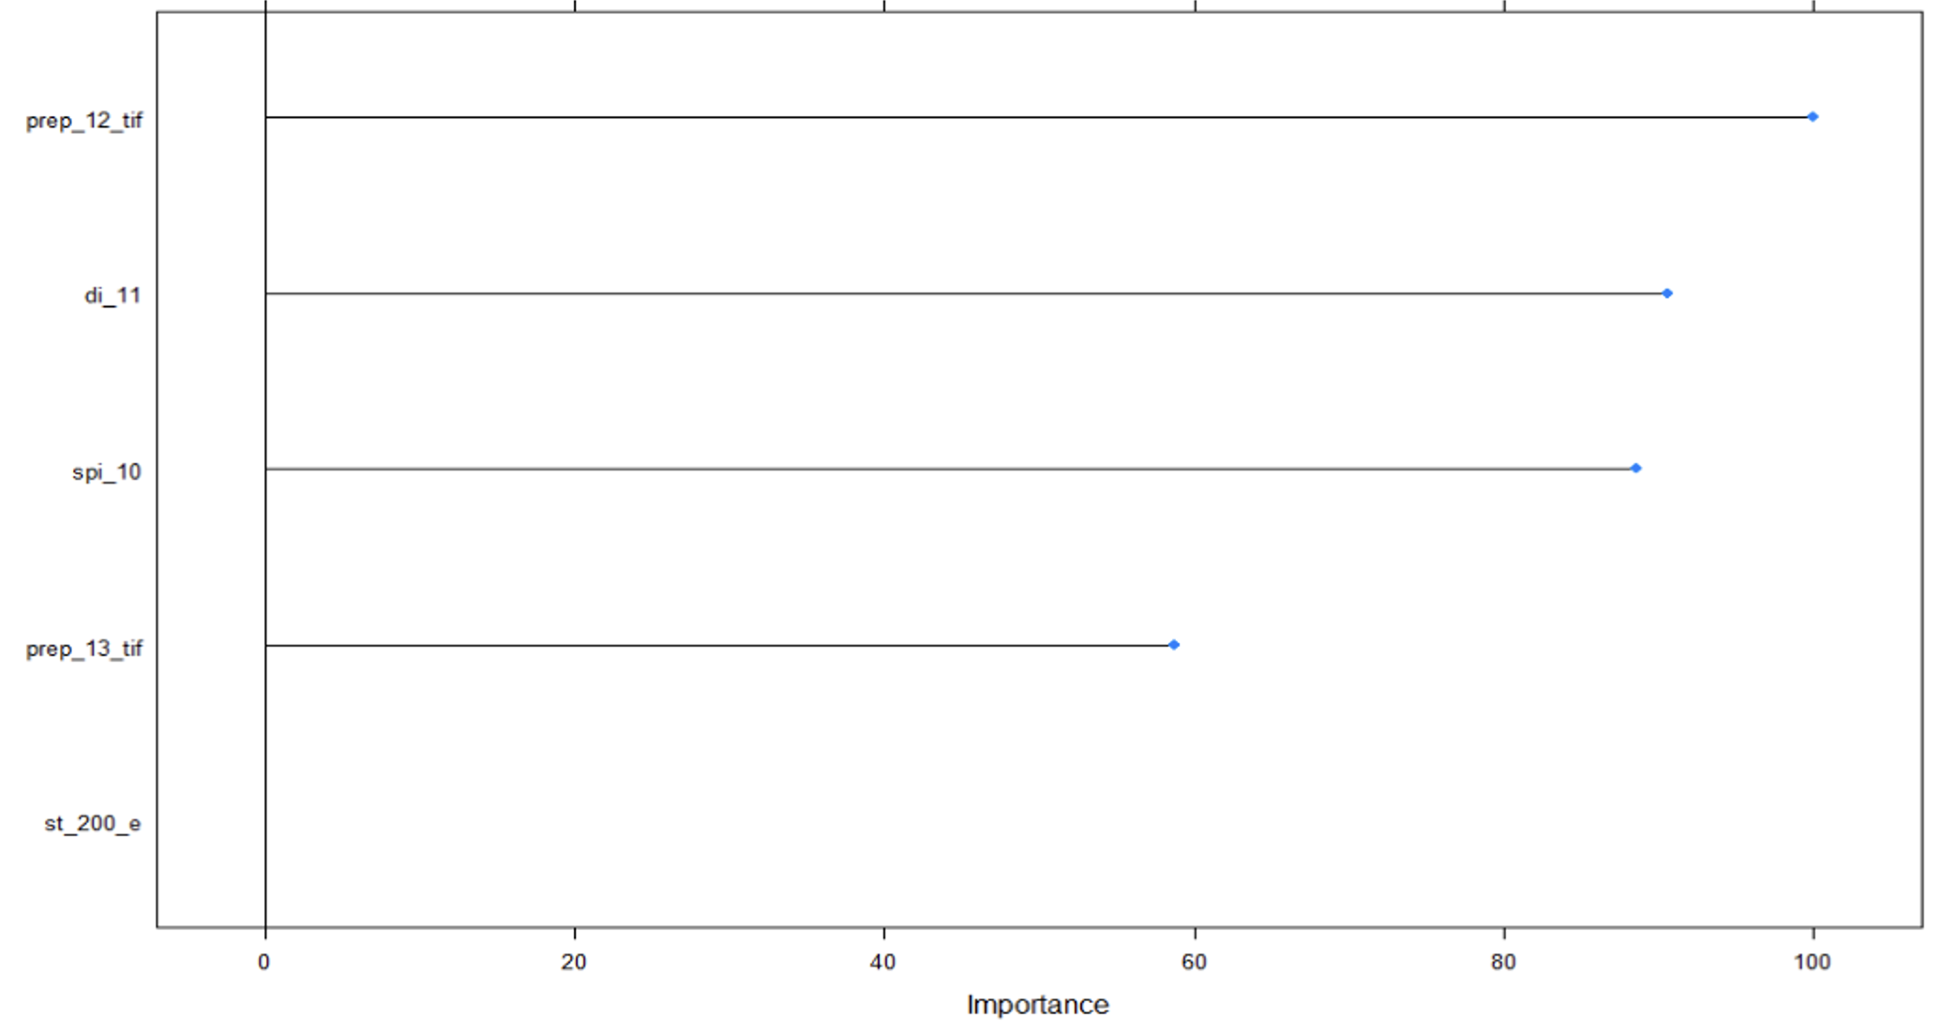
FFS_LLO VarImp Soc 10 – 30 cm
Prism Precp Index
Draught Index
Standard Precp Index
Prism Precp Index
Soil Texture

Slide 29
Limitations
More explanatory Variables could be included such as topography, soil survey e.t.c.
Spatial split should be based on differences in soil types rather than political boundaries

Slide 30
Conclusion

Slide 31
Conclusion and Future work
Using LLO and FFS_LLO methods seem to prevent overfitting in the ML models
For further exploration: Area of applicability in space and time

Slide 32
Thank You
Bulldog Team

